Slide 1
MICROCONTROLLERS AND EMBEDDED SYSTEMS 20XW32
INTRODUCTION

Slide 2
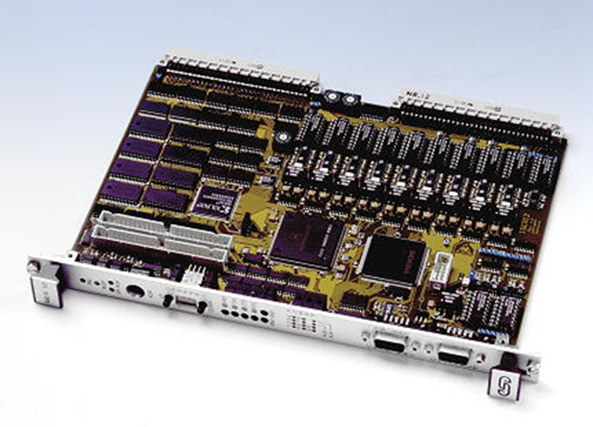
What is Microprocessor?
A silicon chip that contains a CPU. In the world of personal computers, the terms microprocessor and CPU are used interchangeably.
At the heart of all personal computers and most workstations sits a microprocessor.
Microprocessors also control the logic of almost all digital devices, from clock radios to fuel-injection systems for automobiles

Slide 3
Microprocessor def.. Con..
A computer of fourth generation has a microprocessor.
Microprocessor is a programmable device
It can be instructed to perform given tasks with in its capability.
The programmer selects instruction from the list and determines the sequence of execution for a given task.
It takes input from the input device and process the input as it behaves like a CPU and gives the output.

Slide 4
Applications
Instrumentation ( Frequency counters, function generators, frequency synthesizers, spectrum analyses,, Complex Industrial Controllers)
vehicle systems for automobiles, subways, aircraft, railways, and ships
traffic control for highways, airspace, railway tracks, and shipping lanes
process control for power plants, chemical plants, and consumer products such as soft drinks and beer
medical systems for radiation therapy, patient monitoring, and defibrillation
military uses such as firing weapons, tracking, and command and control
telephone, radio, and satellite communications, computer games
multimedia systems that provide text, graphic, audio, and video interfaces
household systems for monitoring and controlling appliances
building managers that control such entities as heat, lights, doors, and elevators

Slide 5


Slide 6
Real life applications of microprocessor
Microprocessors are used to handle a set of tasks that control one or more external events or systems.
Microprocessors are typically used in either reactive or embedded systems.
Reactive systems are those that have an ongoing interaction with their environment - for example, a fire-control system that constantly reacts to buttons pressed by a pilot.
Embedded systems are those used to control specialized hardware in which the computer system is installed - for example, the microprocessor system used to control the fuel/air mixture in the carburetor of many automobiles. appliances
In embedded systems the software system is completely encapsulated by the hardware that it controls.

Slide 7
Continued…
Often the processor is required to manage various different tasks that have to be scheduled somehow and must also deal with outside interrupt sources such as an alarm when something goes wrong.
Real-time systems are those in which timeliness is as important as the correctness of the outputs, although this does NOT mean that they have to be fast systems.
A real-time system does not have to process data in microseconds to be considered real-time - it must simply have response times that are constrained and thus predictable.

Slide 8
Microprocessors vs. Microcontrollers
Microprocessor consists of only a Central Processing Unit, whereas Micro Controller contains a CPU, Memory, I/O all integrated into one chip.
Microprocessor is used in Personal Computers whereas Micro Controller is used in an embedded system.
Microprocessor uses an external bus to interface to RAM, ROM, and other peripherals, on the other hand, Microcontroller uses an internal controlling bus.
Microprocessors are based on Von Neumann model & Micro controllers are based on Harvard architecture
Microprocessor is complicated and expensive, with a large number of instructions to process but Microcontroller is inexpensive and straightforward with fewer instructions to process.

Slide 9
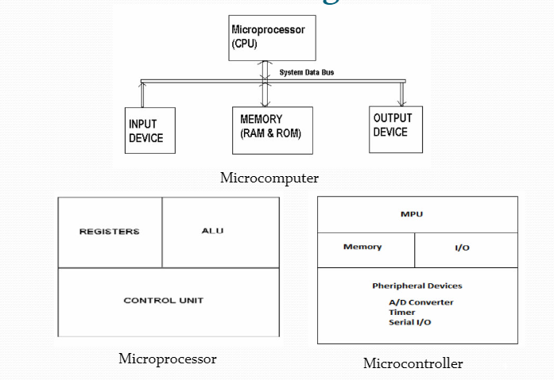

Slide 10
Microprocessors | Microcontrollers
Microprocessor is the heart of Computer system. | Micro Controller is the heart of an embedded system.
Memory and I/O has to be connected externally, so the circuit becomes large. | Memory and I/O are already present, and the internal circuit is small.
You can't use it in compact systems | You can use it in compact systems.
Cost of the entire system is high | Cost of the entire system is low
Due to external components, the total power consumption is high. Therefore, it is not ideal for the devices running on stored power like batteries. | As external components are low, total power consumption is less. So it can be used with devices running on stored power like batteries.
It's used for general purpose applications that allow you to handle loads of data., mainly used in personal computers. | It's used for application-specific systems like washing machine, MP3 players, and embedded systems.
Microprocessor has a smaller number of registers, so more operations are memory-based. | Microcontroller has more register. Hence the programs are easier to write.
Microprocessor-based systems can run at a very high speed because of the technology involved. | Microcontroller based systems run up to 200MHz or more depending on the architecture.
It has no RAM, ROM, Input-Output units, timers, and other peripherals on the chip. | It has a CPU along with RAM, ROM, and other peripherals embedded on a single chip.

Slide 11
Microprocessor
Fifth Generation Pentium
Fourth Generation
During 1980s
Low power version of HMOS technology (HCMOS)
32 bit processors
Physical memory space 2²⁴ bytes = 16 Mb
Virtual memory space 2⁴⁰ bytes = 1 Tb
Floating point hardware
Supports increased number of addressing modes
Intel 80386
Third Generation
During 1978
HMOS technology ⇒ Faster speed, Higher packing density
16 bit processors ⇒ 40/ 48/ 64 pins
Easier to program
Dynamically relatable programs
Processor has multiply/ divide arithmetic hardware
More powerful interrupt handling capabilities
Flexible I/O port addressing
Intel 8086 (16 bit processor)
Second Generation
During 1973
NMOS technology ⇒ Faster speed, Higher density, Compatible with TTL
4 / 8/ 16 bit processors ⇒ 40 pins
Ability to address large memory spaces and I/O ports
Greater number of levels of subroutine nesting
Better interrupt handling capabilities
Intel 8085 (8 bit processor)
First Generation
Between 1971 – 1973
PMOS technology, non compatible with TTL
4 bit processors ⇒ 16 pins
8 and 16 bit processors ⇒ 40 pins
Due to limitations of pins, signals are multiplexed

Slide 12
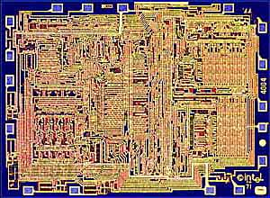
In the beginning (8-bit) Intel 4004
First general-purpose, single-chip microprocessor
Shipped in 1971
8-bit architecture, 4-bit implementation
2,300 transistors
Performance < 0.1 MIPS (Million Instructions Per Sec)
8008: 8-bit implementation in 1972
3,500 transistors
First microprocessor-based computer (Micral)
Targeted at laboratory instrumentation
Mostly sold in Europe

Slide 13
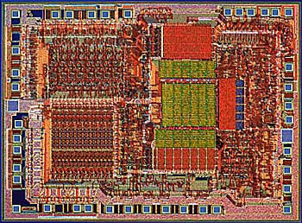
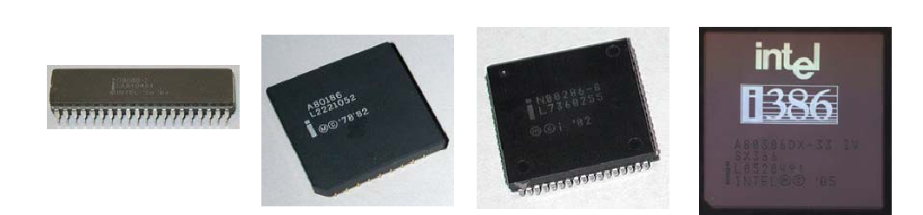
1st Generation (16-bit) Intel 8086
Introduced in 1978
Performance < 0.5 MIPS
New 16-bit architecture
“Assembly language” compatible with 8080
29,000 transistors
Includes memory protection, support for Floating Point coprocessor
In 1981, IBM introduces PC
Based on 8088--8-bit bus version of 8086

Slide 14
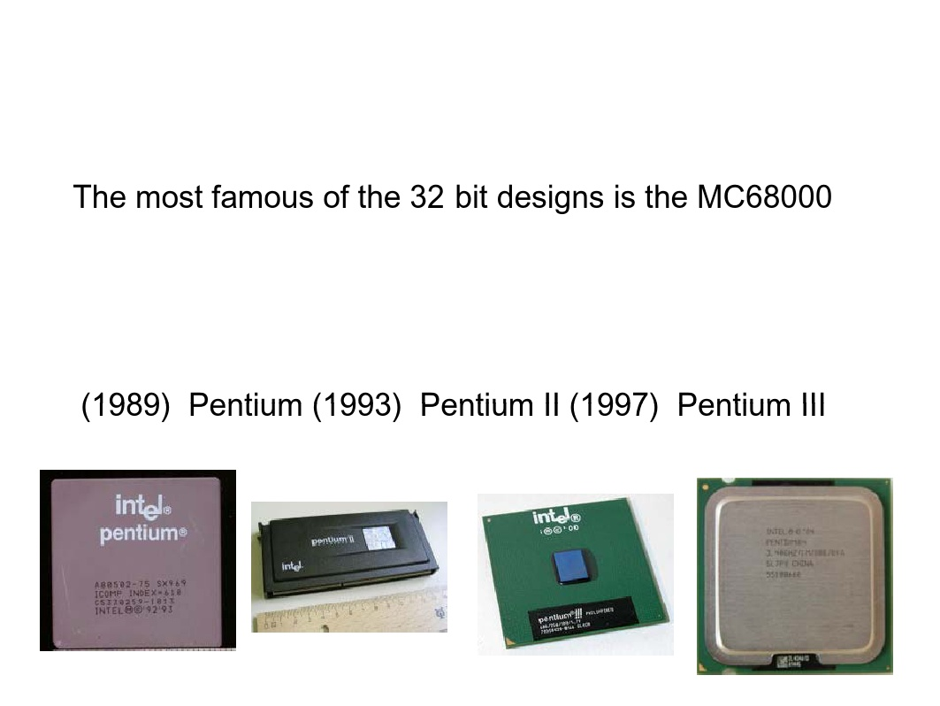
2nd Generation (32-bit)
First 32-bit architecture
initial 16-bit implementation
First flat 32-bit address
Support for paging
General-purpose register architecture
Loosely based on PDP-11 minicomputer
Intel iAPX 432was Intel's first 32-bit microprocessor design, introduced in 1981. Then Intel introduced 80486, PentiumIII (1999), Pentium 4 (2001)
Used in
Apple Mac
Sun ,
Silicon Graphics
Apollo workstations

Slide 15
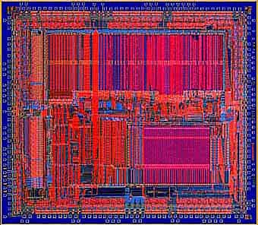
3rd Generation: MIPS R2000
Several firsts:
First (commercial) RISC microprocessor
First microprocessor to provide integrated support for instruction & data cache
First pipelined microprocessor (sustains 1 instruction/clock)
Implemented in 1985
125,000 transistors
5-8 MIPS (Million Instructions per Second)

Slide 16
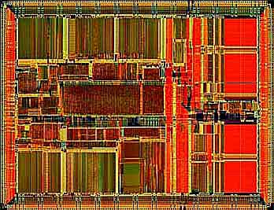
4th Generation (64 bit) MIPS R4000
First 64-bit architecture
Integrated caches
On-chip
Support for off-chip, secondary cache
Integrated floating point
Implemented in 1991:
Deep pipeline
1.4M transistors
Initially 100MHz
> 50 MIPS
Intel translates 80x86/ Pentium X instructions into RISC internally

Slide 17
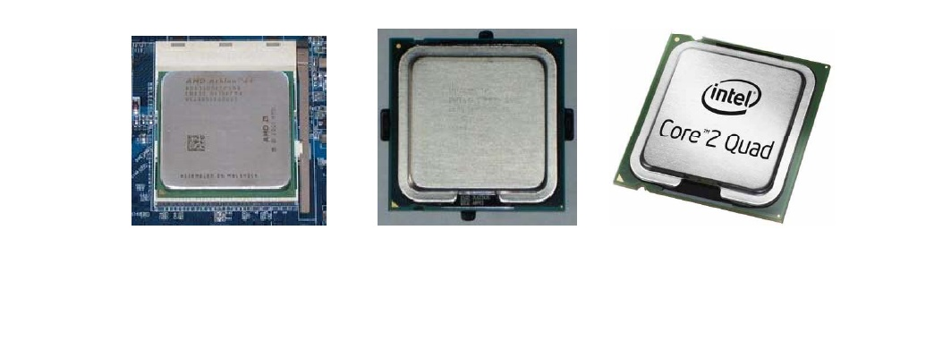
Fifth Gen of Microprocessor (64 bit)
AMD's introduced the first 64-bit AMD64 in September2003.
Followed by Intel’s Pentium 5,Duo Core 2006 and Quad Core (2008)
Using improved memory technologies and energy-efficient chipsets, they work faster and use less energy than any previous Intel CPUs.
The 7th generation Core i3, Core i5 and Core i7 desktop processors (2007, 2009, 2010)consume as little as 35W of power – with even the top-end CPU consuming a mere 95W.

Slide 18
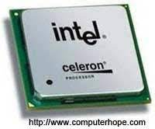
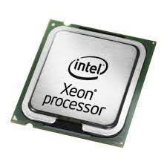
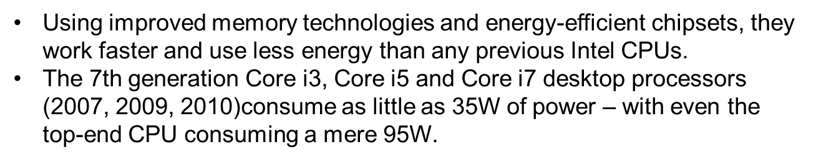
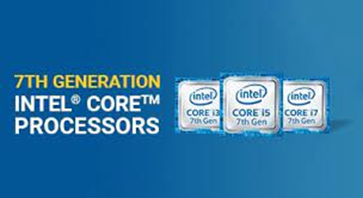
Intel Celeron
Introduced in 1998
Based on Pentium 2 and can run all IA 32 pgms
Xeon
400MHz Pentium processor from Intel used
in workstations and enterprise servers
Designed for MM applications, graphcsand large DB servers, etc.,

Slide 19
Intel® Xeon™
For workstations and servers.
Based on Intel NetBurst™ architecture, which is designed to deliver the processing power needed for video and audio applications, advanced Internet technologies, and complex 3-D graphics.

Slide 20
Itanium™ Processor
Full 64-bit capability.
For high-end, enterprise-class servers and workstations.
The processor was built from the ground up with an entirely new architecture based on Intel's Explicitly Parallel Instruction Computing (EPIC) design technology.

Slide 21
Key Architectural Trends
Increase performance at 1.6x per year (2X/1.5yr)
True from 1985-present
Combination of technology and architectural enhancements
Technology provides faster transistors (∝ 1/lithographic feature size) and more of them
Faster transistors leads to high clock rates
More transistors (“Moore’s Law”):
Architectural ideas turn transistors into performance
Responsible for about half the yearly performance growth
Two key architectural directions
Sophisticated memory hierarchies
Exploiting instruction level parallelism

Slide 22
Levels of cache
At the microprocessor level, cache refers units of SRAM used to speed up the processor’s interaction with memory.
Level 1 (L1) or primary cache is built onto the processor chip.
Level 2 (L2) or secondary cache originally was packaged separately from the processor (so one could change the amount of it) but started to be included as part of the processor package (around the time of the Pentium II).
In the latter case, one can have Level 3 (L3) cache which is separate from the processor package.

Slide 23
Memory Hierarchies
Caches: hide latency of DRAM and increase BW
CPU-DRAM access gap has grown by a factor of 30-50!
Trend 1: Increasingly large caches
On-chip: from 128 bytes (1984) to 100,000+ bytes
Multilevel caches: add another level of caching
First multilevel cache:1986
Secondary cache sizes today: 128,000 B to 16,000,000 B
Third level caches: 1998
Trend 2: Advances in caching techniques:
Reduce or hide cache miss latencies
Cache aware combos: computers, compilers, code writers
prefetching: instruction to bring data into cache early

Slide 24
Exploiting Instruction Level Parallelism (ILP)
ILP is the implicit parallelism among instructions (programmer not aware)
Exploited by
Overlapping execution in a pipeline
Issuing multiple instruction per clock
superscalar: uses dynamic issue decision (HW driven)
VLIW: uses static issue decision (SW driven)
1985: simple microprocessor pipeline (1 instr/clock)
1990: first static multiple issue microprocessors
1995: sophisticated dynamic schemes
determine parallelism dynamically
execute instructions out-of-order
speculative execution depending on branch prediction
“Off-the-shelf” ILP techniques yielded 15 year path of 2X performance every 1.5 years => 1000X faster!

Slide 25
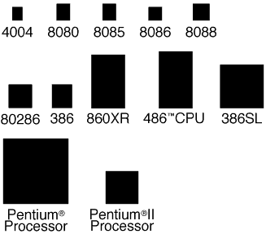
Relative Processor size
This diagram shows the relative sizes of the Intel family of microprocessors. While the number of transistors has grown substantially the size of the chip has not – imply that the density (the number of transistors per area) has increased dramatically.

Slide 26
FPU
Floating point operations are more tedious to perform than integer operations.
The floating point unit (FPU) is circuitry devoted to floating point operations.
In processors of the 8086 generation, the FPU was not standard but could be purchased as a separate chip (known in this case as a Math co-processor).
In modern processors, the FPU can also help with multimedia and communications.

Slide 27
Protected mode
Allows multi-tasking so that the processor can juggle more than one program at a time.
Each program is assigned to a certain range of memory. Only that program can use that range of memory. It is “protected” from interference by other programs. And other programs are protected form it.
Uses extended memory and virtual memory so that a program seems to have access to more memory than it is assigned.

Slide 28
Branch prediction
Pre-processing consecutive instructions will not help with speed when the next instruction to be executed is not the next instruction in the program (ifs, loops, subroutines, etc.)
Starting with some Pentiums, microprocessors included a branch prediction feature.

Slide 29
MMX/SIMD
Some Pentiums have MMX.
MultiMedia eXtensions?
Matrix Math eXtensions?
57 additional instructions for making audio and video more efficient.
Some Pentiums have Single Instruction Multiple Data (SIMD).
One instruction can be used to operate on many pieces of data in parallel.

Slide 30
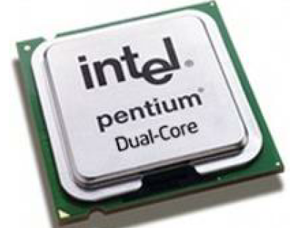
Intel Dual Core
Introduced in 2006.
➢ It is 32-bit or 64-bit µP.
➢ It has two cores.
➢ Both the cores have there
own internal bus and L1 cache, but share the external bus and L2 cache
➢ It supported SMT technology.

Slide 31
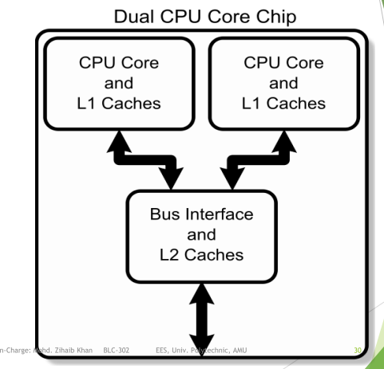
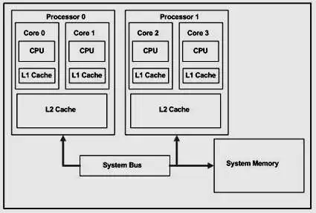

Slide 32
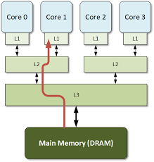
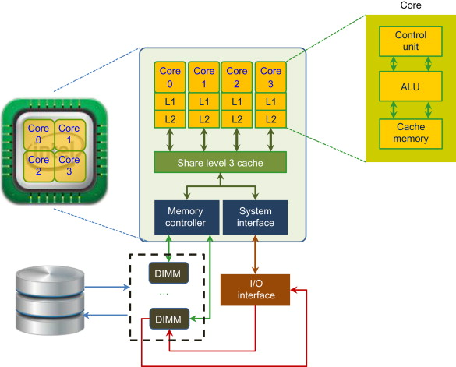

Slide 33
Characterstics which differentiate microprocessors
Instruction set: The set of instructions that the microprocessor can execute.
Bandwidth : The number of bits processed in a single instruction.
Clock speed : Given in (MHz/GHz), the clock speed determines how many instructions per second the processor can execute.

Slide 34
Microprocessor types
Microprocessors can be characterized based on
the word size
8 bit, 16 bit, 32 bit, etc. processors
Instruction set Architecture
RISC (Reduced Instruction Set Computer), CISC (Complex Instruction Set Computer)
Functions
General purpose, special purpose such image processing, floating point calculations
And more …

Slide 35
Based on size of data bus:
4-bit microprocessor
8-bit microprocessor
16-bit microprocessor
32-bit microprocessor
Based on architecture:
Reduced Instruction Set Computer (RISC) processors
Complex Instruction Set Computer (CISC) processors

Slide 36
Based on application:
General-purpose microprocessor- used in general computer system and can be used by programmer for any application. Examples, 8085 to Intel Pentium.
Microcontroller- microprocessor with built-in memory and ports and can be programmed for any generic control application. Example, 8051.
Special-purpose processors- designed to handle special functions required for an application. Examples, digital signal processors and application-specific integrated circuit (ASIC) chips.

Slide 37
Definition of the Microprocessor
Microprocessor is a Programmable, Clock driven, Register based, Electronic device that reads instruction from a storage device, takes the data from input unit and process the data according to the instructions and provides the result to the output unit.
Programmable- Perform Different set operation on the data depending on the sequence of instructions supplied by the programmer.
Clock Driven – Whole task is divided into basic operations, are divided into precise system clock periods.
Register Based – Storage element
Electronic Device – fabricated on a chip

Slide 38
Typical microprocessors
Most commonly used
68K
Motorola
x86
Intel
IA-64
Intel
MIPS
Microprocessor without interlocked pipeline stages
ARM
Advanced RISC Machine
PowerPC
Apple-IBM-Motorola alliance
Atmel AVR

Slide 39
Instructions
This is the key part of an ISA
specifies the basic operations available to a programmer
Example:
Arithmetic instructions
Instruction set is machine oriented
Different machine, different instruction set
For example
68K has more comprehensive instruction set than ARM

Slide 40
Processor Data and Address Bus Sizes Examples
Processor
8088
8086
80286
80386dx
80486
80586/Pentium (Pro)
Data Bus
8
16
16
32
32
64
Address Bus
20
20
24
32
32
32
Max Addressable Memory
1,048,576 (1Mb)
1,048,576 (1Mb)
16,777,21 (16Mb)
4,294,976,296 (4Gb)
4,294,976,296 (4Gb)
4,294,976,296 (4Gb)

Slide 41
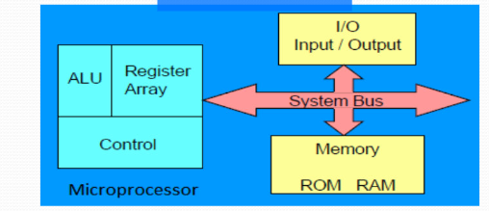
Microprocessor Based System with bus Architecture
ALU:- Arithmetic and logical operations like add, subtraction, AND & OR.
Register Array: - Store data during the execution of program.
Control Unit: Provides necessary timing & control signal. It controls the flow of data between microprocessor and peripherals.

Slide 42
Internal structure and basic operation of microprocessor
ALU
Register Section
Address bus
Data bus
Control and timing section
Control bus
Block diagram of a microprocessor

Slide 43
Arithmetic and logic unit (ALU)
The component that performs the arithmetic and logical operations
the most important components in a microprocessor, and is typically the part of the processor that is designed first.
able to perform the basic logical operations (AND, OR), including the addition operation.

Slide 44
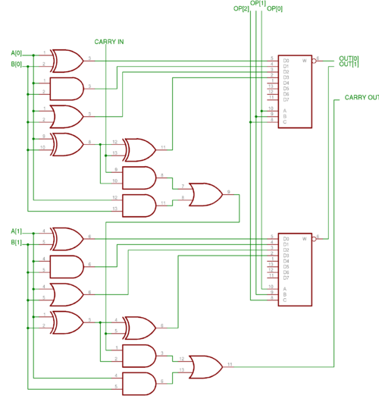
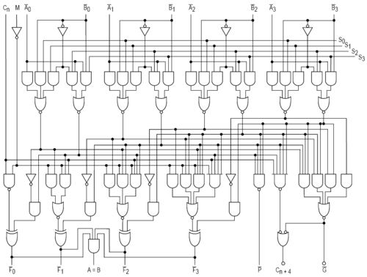
Internal structure of ALU
2 bits of ALU
4 bits of ALU

Slide 45
Control unit
The circuitry that controls the flow of information through the processor, and coordinates the activities of the other units within it.
In a way, it is the "brain within the brain", as it controls what happens inside the processor, which in turn controls the rest of the PC.
On a regular processor, the control unit performs the tasks of fetching, decoding, managing execution and then storing results.

Slide 46
Register sets
The register section/array consists completely of circuitry used to temporarily store data or program codes until they are sent to the ALU or to the control section or to memory.
The number of registers are different for any particular CPU and the more register a CPU have will result in easier programming tasks.
Registers are normally measured by the number of bits they can hold, for example, an "8-bit register" or a "32-bit register".

Slide 47

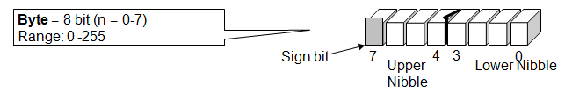
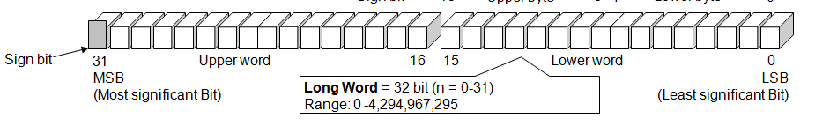
DATA SIZE
Nibble | 4 bit
Byte | 8 bit
Word | 16 bit
Long word | 32 bit

Slide 48
Data bus
The data bus is 'bi-directional'
data or instruction codes from memory or input/output.are transferred into the microprocessor
the result of an operation or computation is sent out from the microprocessor to the memory or input/output.
Depending on the particular microprocessor, the data bus can handle 8 bit or 16 bit data.

Slide 49
Address bus
The address bus is 'unidirectional', over which the microprocessor sends an address code to the memory or input/output.
The size (width) of the address bus is specified by the number of bits it can handle.
The more bits there are in the address bus, the more memory locations a microprocessor can access.
A 16 bit address bus is capable of addressing 65,536 (64K) addresses.

Slide 50
Control bus
The control bus is used by the microprocessor to send out or receive timing and control signals in order to coordinate and regulate its operation and to communicate with other devices, i.e. memory or input/output.

Slide 51
How does a Microprocessor works
To execute a program, the microprocessor “reads” each instruction from memory, “interprets” it, then “executes or perform” it.
The right name for the cycle is
Fetch
Decode
Execute
This sequence is continued until all instructions are performed.

Slide 52
Program counter (PC)
a 16 bit register, used to store the next address of the operation code to be fetched by the CPU.
Not much use in programming, but as an indicator to user only.
Purpose of PC in a Microprocessor
to store address of tos (top of stack)
to store address of next instruction to be executed.
count the number of instructions.

Slide 53
Stack pointer (SP)
The stack is configured as a data structure that grows downward from high memory to low memory.
At any given time, the SP holds the 16-bit address of the next free location in the stack.
The stack acts like any other stack when there is a subroutine call or on an interrupt. ie. pushing the return address on a jump, and retrieving it after the operation is complete to come back to its original location.

Slide 54
Flag | Name | Description
Z | Zero flag | Indicates that the result of a mathematical or logical operation was zero.
C | Carry flag | Indicates that the result of an operation produced an answer greater than the number of available bits. (This flag may also be set before a mathematical operation as an extra operand to certain instructions, e.g. "add with carry".)
X | Extend flag | Masks the XIRQ request when set. It is set by the hardware and cleared by the software as well is set by unmaskable XIRQ.
N | Negative/ Sign flag | Indicates that the result of a mathematical operation is negative. In some processors, the N and S flags have different meanings: the S flag indicates whether a subtraction or addition has taken place, whereas the N flag indicates whether the last operation result is positive or negative.
V | Overflow Flag | Indicates that the result of an operation has overflowed according to the CPU's word representation, similar to the carry flag but for signed operations.
I | interrupts | Interrupts can be enabled or disabled by respectively setting or clearing this flag. Modifying this flag may be restricted to programs executing in supervisor mode

Slide 55
Micro processor clock
Also called clock rate, the speed at which a microprocessor executes instructions. Every computer contains an internal clock that regulates the rate at which instructions are executed and synchronizes all the various computer components.

Slide 56
ISA
Stands for Instruction Set Architecture
Provides functional specifications for software programmers to use/program hardware to perform certain tasks
Provides the functional requirements for hardware designers so that their hardware design (called micro-architectures) can execute software programs.

Slide 57
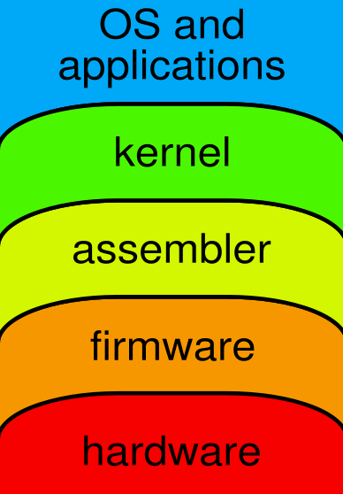
Programming THE PROCESSOR
Interpreted High Level Language
Compiled High Level Language
Assembly Language
Machine Language

